Slide 1



Unmanned Aerial System (UAS) for Wildlife Tracking
Presenter: Chris Gass
Mentor: Dr. Michael Shafer
Northern Arizona University

Slide 2
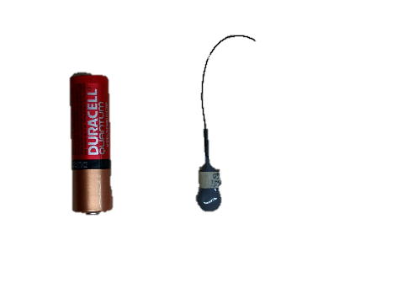
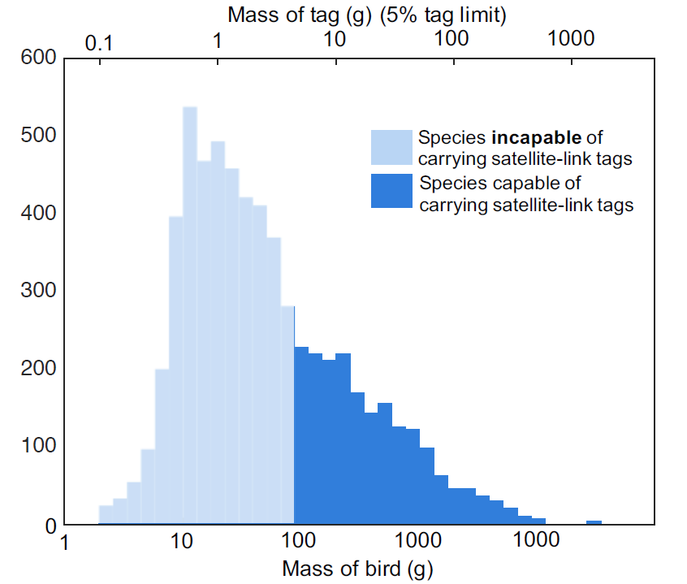
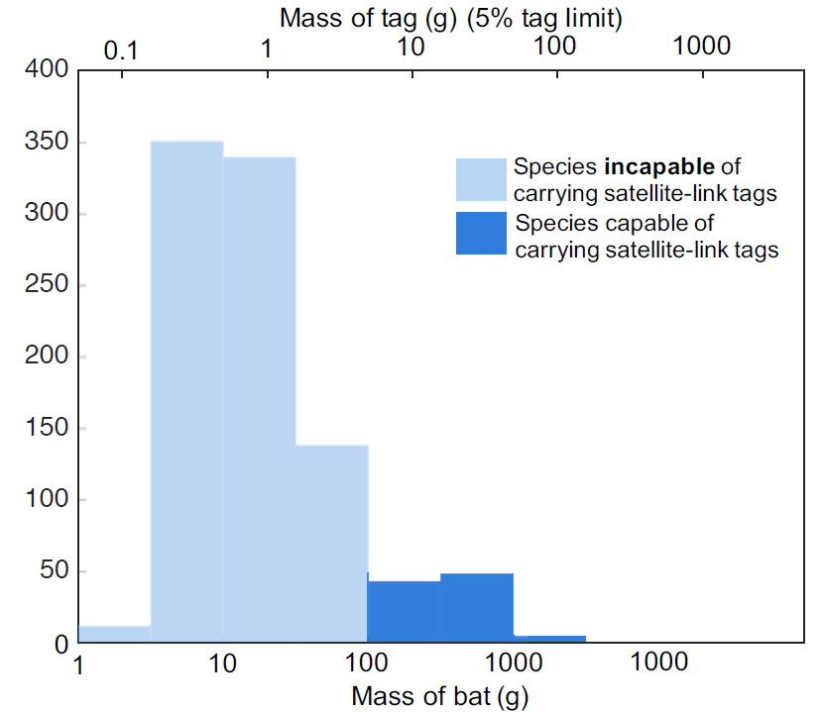
Introduction – Wildlife Tracking
Background on wildlife tracking:
  Animals are tagged with transmitters
    Smaller animals must use small, non satellite-link tags
    Researchers must locate transmitters with handheld antennas
Purpose of this project:
  Utilize a UAS to provide enhanced wildlife tracking abilities for researchers in the field

Slide 3
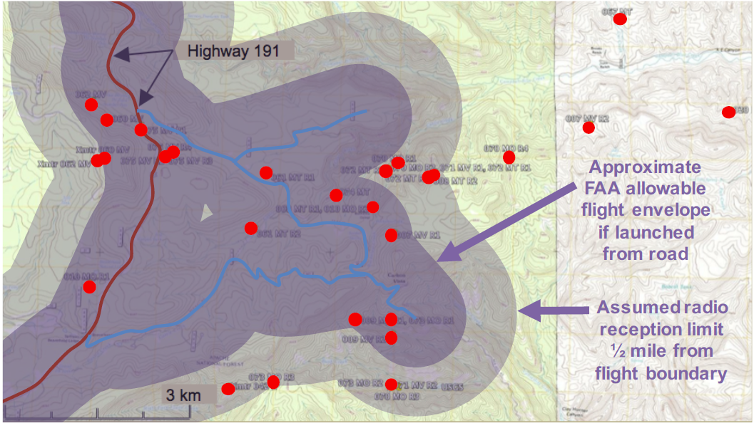
Introduction - UAS
Bat roost site
Unmanned Aerial System/Vehicle (UAS/UAV) or Drone:
  Autonomous or remotely controlled flying vehicle
Benefits of a UAS for wildlife tracking:
  Increased reception range
  Ability to avoid rough terrain
  Decreased time required to track each animal

Slide 4
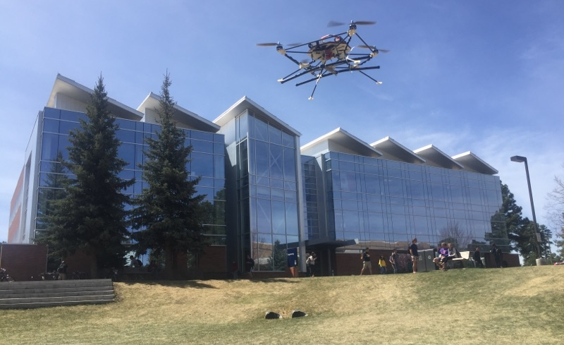
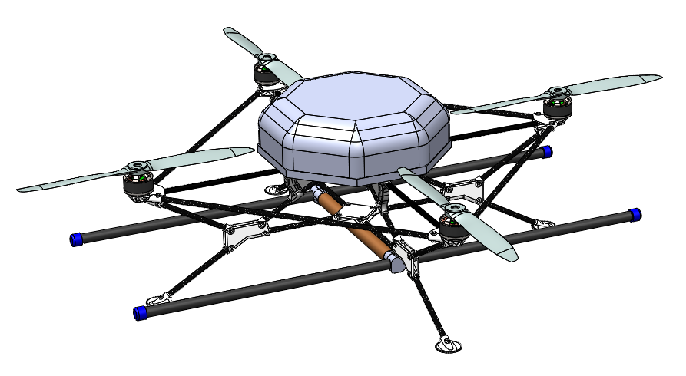
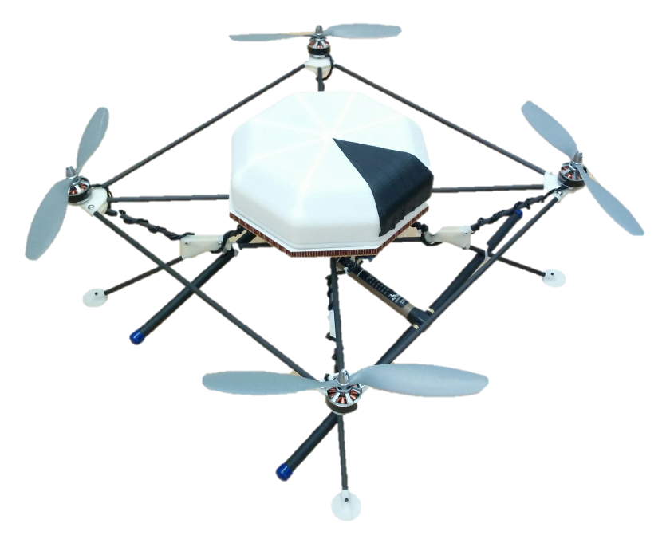

Quadcopter
Motor and component specification:
  Heavy-lift quadcopter desired
    ~5-6 lb all-up weight
    Including ~1 lb science payload
  Durability and reliability for field use
  Ease of construction and repair
6.14”

Slide 5
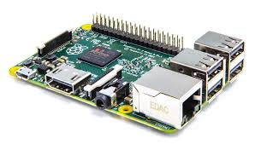
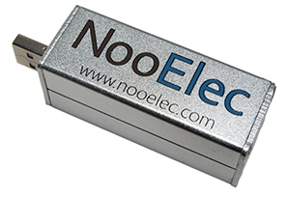
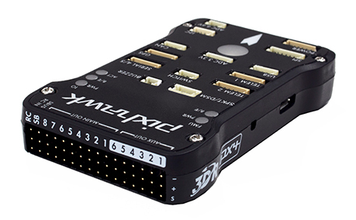
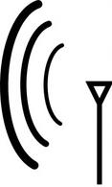
Data Collection
Data collected on a Raspberry Pi:
  Software-Defined Radio (SDR) receives signal from the antenna
  Flight controller sends telemetry data to Raspberry Pi
  Raspberry Pi transmits data to Ground Station over wireless network
Telemetry Data from Flight Controller
Raspberry Pi
Transmitter
(On animal)
Ground Station
Antenna and SDR

Slide 6
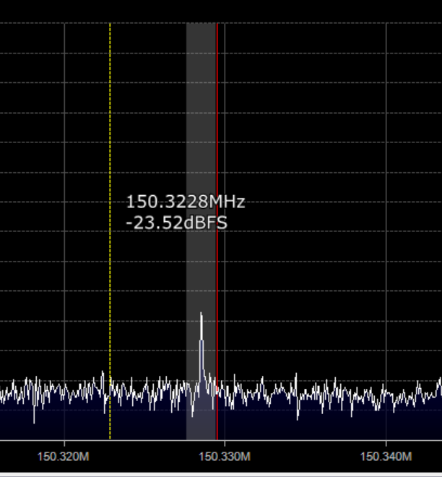
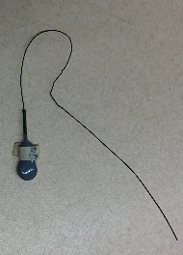
Analysis
Signal analysis on Ground Station
  SDR# Program provides power spectrum and spectrograms
Relative Signal Strength
Max. Signal Strength
Frequency (Hz)

Slide 7
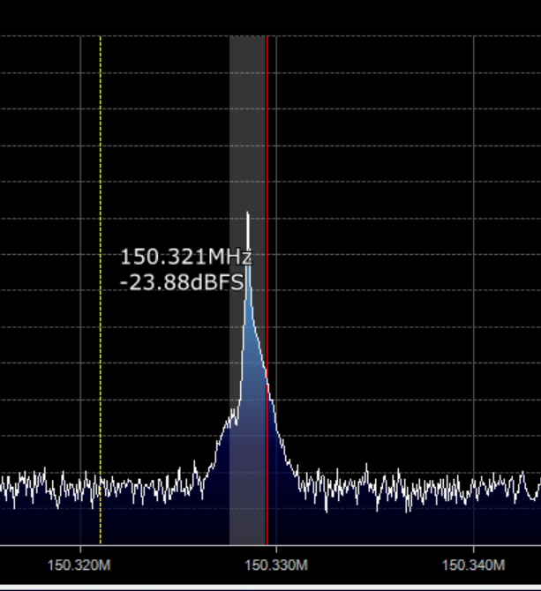
Analysis
Signal analysis on Ground Station
  SDR# Program provides power spectrum and spectrograms
Max. Signal Strength
Relative Signal Strength
Min. Signal Strength
Frequency (Hz)

Slide 8
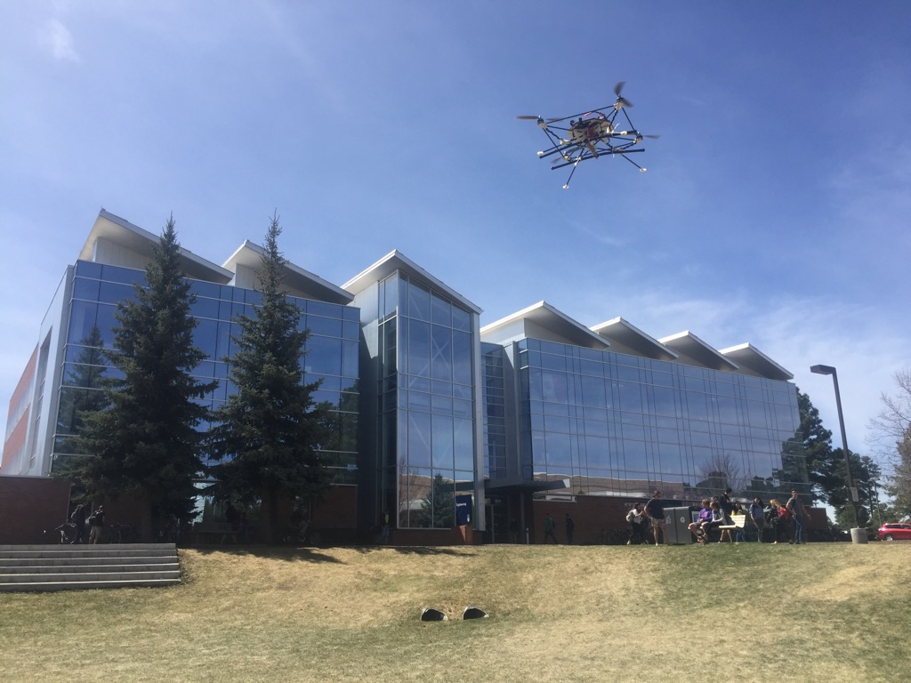
Conclusion and Continued Work
UAV capable of flight with full payload
Data acquisition from antenna and SDR using Raspberry Pi
Integration of signal data and telemetry data in Matlab
  Provides direction of strongest signal intensity

Slide 9
Future Work
Lighten frame further and improve portability of the system
Continue development of Matlab algorithm for locating signals
Acknowledgements:
  NASA Space Grant
    Dr. Nadine Barlow
    Kathleen Stigmon
  Dr. Michael Shafer
  Joe Davidson
  Kellan Rothfus
Questions?

